Slide 1
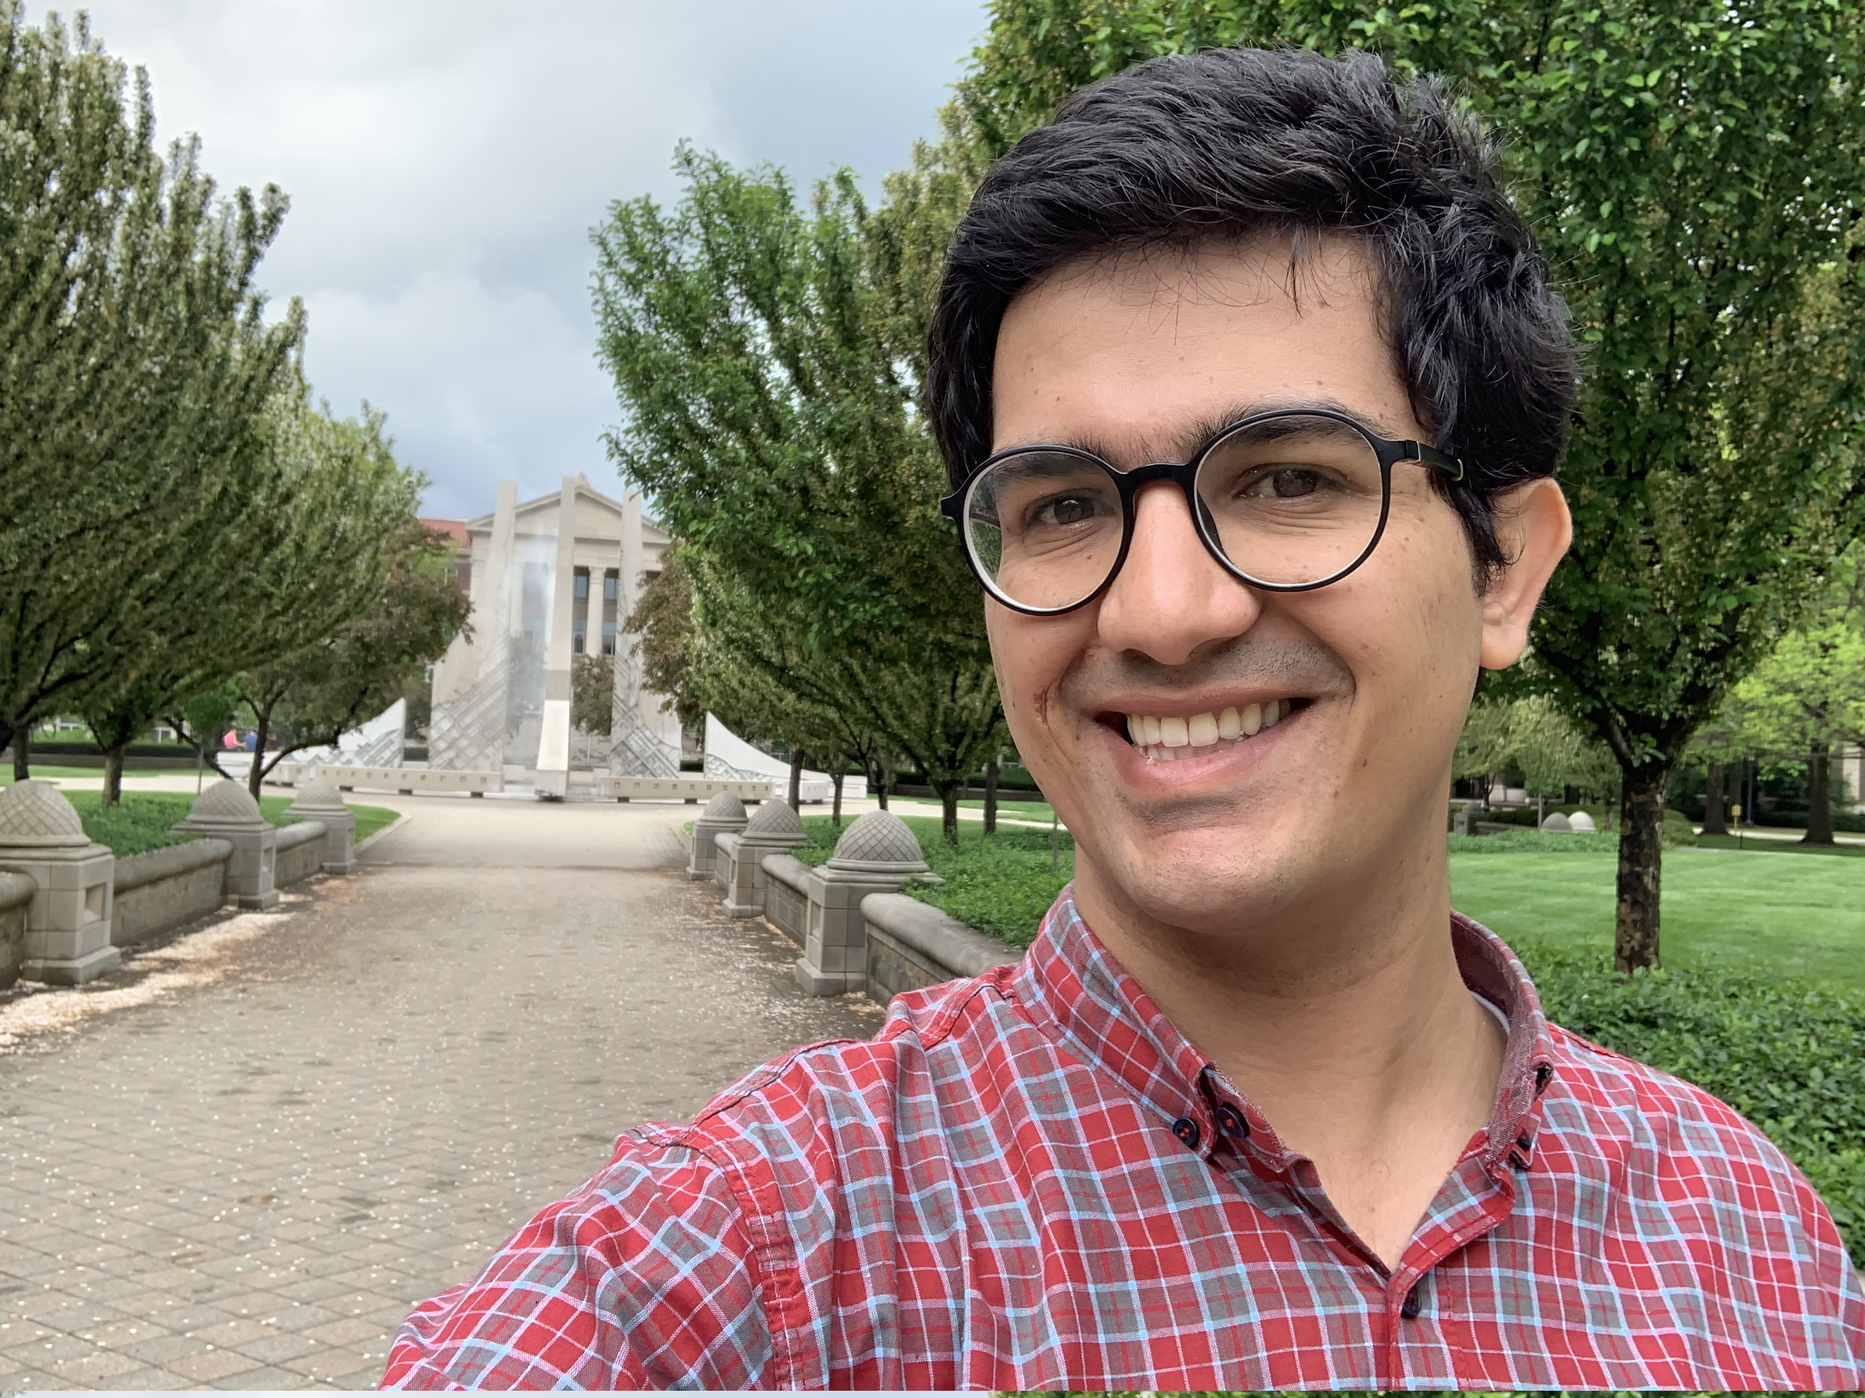

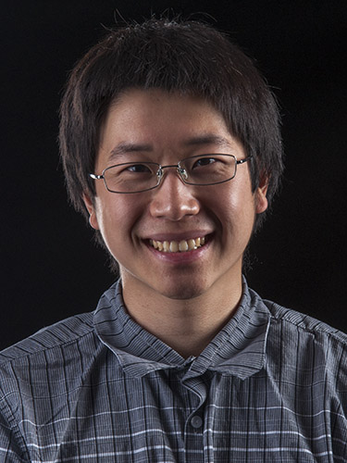



Computationally Data-Independent Memory Hard Functions
MOHAMMAD HASSAN AMERI
JEREMIAH BLOCKI
SAMSON ZHOU

Slide 2
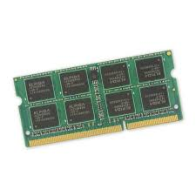
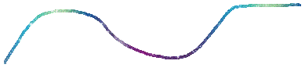
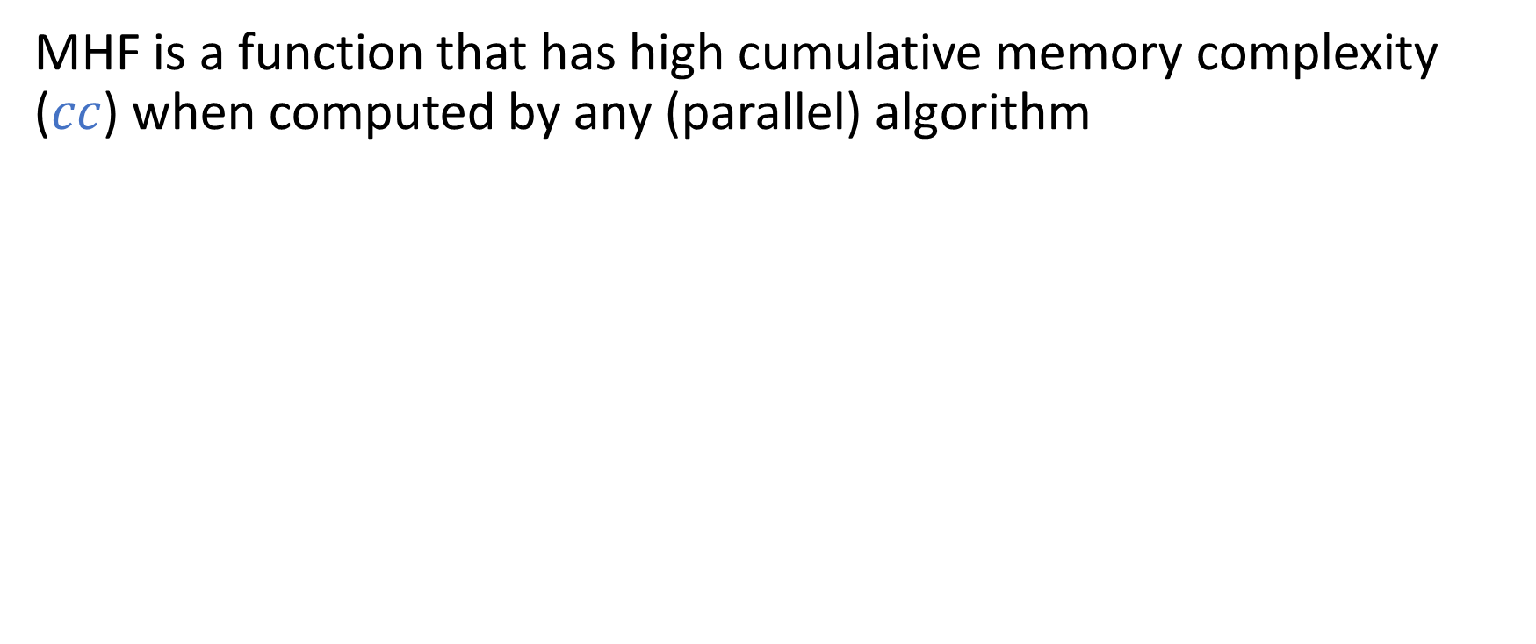
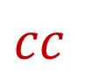
Memory Hard Functions [ABMW05, Percival09]
MHF is a function that has high cumulative memory complexity ($cc$) when computed by any (parallel) algorithm
Memory in Use
$$cc$$
Time
Notes:
Let’s start by breaking down what each of the terms in the title means. Informally speaking, a memory hard function is any function that requires a lot of memory to compute. There are various metrics to measure how much memory the computation of a function uses, but in this talk we’ll look at the cumulative memory complexity, or cc, which is the total amount of memory spent over the computation.

Slide 3
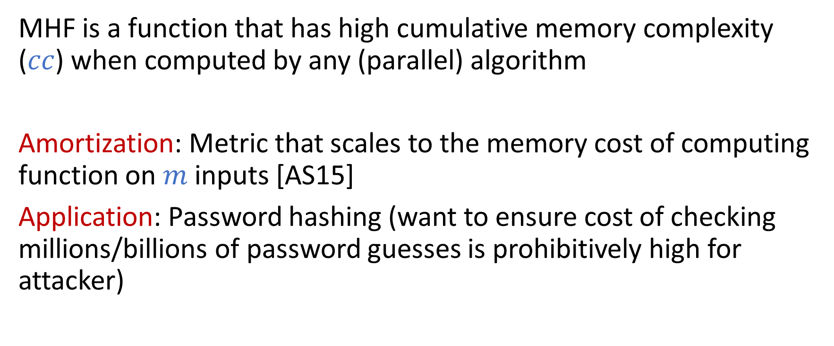
Memory Hard Functions [ABMW05, Percival09]
MHF is a function that has high cumulative memory complexity ($cc$) when computed by any (parallel) algorithm
Amortization: Metric that scales to the memory cost of computing function on $m$ inputs [AS15]
Application: Password hashing (want to ensure cost of checking millions/billions of password guesses is prohibitively high for attacker)
Notes:
Cumulative memory complexity has some nice properties compared to some other metrics. For example, it amortizes nicely, so that the cost of multiple computations is the product of the cost of a single computation and the total number of computations. Hence, it’s often used to evaluate the quality of functions in the context of password hashing, where we want to discourage an adversary from making a large number of parallel guesses, but we still want to authenticate an honest user in a reasonable amount of time.

Slide 4
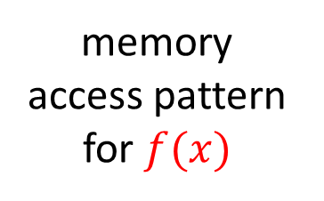
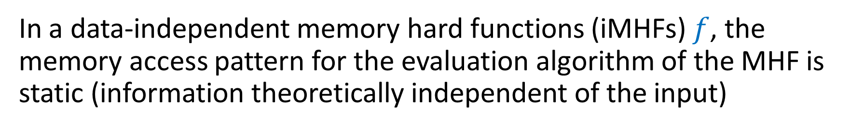
iMHFs
In a data-independent memory hard functions (iMHFs) $f$, the memory access pattern for the evaluation algorithm of the MHF is static (information theoretically independent of the input)
3
2
memory access pattern for $f(x)$
9
8
1
4
5,7
6
10
RAM
Notes:
Broadly speaking, memory hard functions can be classified into two categories. In a data independent memory hard function, or IMHF, the memory access pattern is static across all evaluations of the function on a given input or even different inputs. So let’s suppose this is the memory access pattern for the computation of f(x), where the algorithm first looks at this location in RAM, then this location, then this location, and so forth.

Slide 5
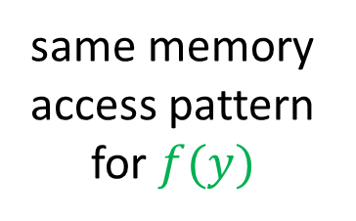
iMHFs
In a data-independent memory hard functions (iMHFs) $f$, the memory access pattern for the evaluation algorithm of the MHF is static (information theoretically independent of the input)
3, 3
2, 2
same memory access pattern for $f(y)$
9, 9
8, 8
1, 1
4, 4
5, 5, 7, 7
6, 6
10, 10
RAM
Notes:
Then the memory access pattern will still be the same for the computation of f(y) for a different value of y.

Slide 6
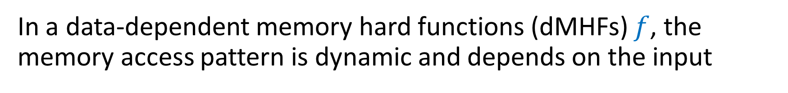
dMHFs
In a data-dependent memory hard functions (dMHFs) $f$, the memory access pattern is dynamic and depends on the input
3
2
memory access pattern for $f(x)$
9
8
1
4
5,7
6
10
RAM
Notes:
On the other hand, in a data-dependent memory hard function, or dMHF, the memory access pattern is dynamic and depends on the input. So let’s say we have the following memory access pattern for the computation of f(x).

Slide 7
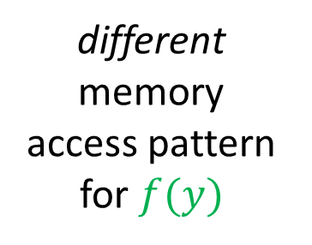
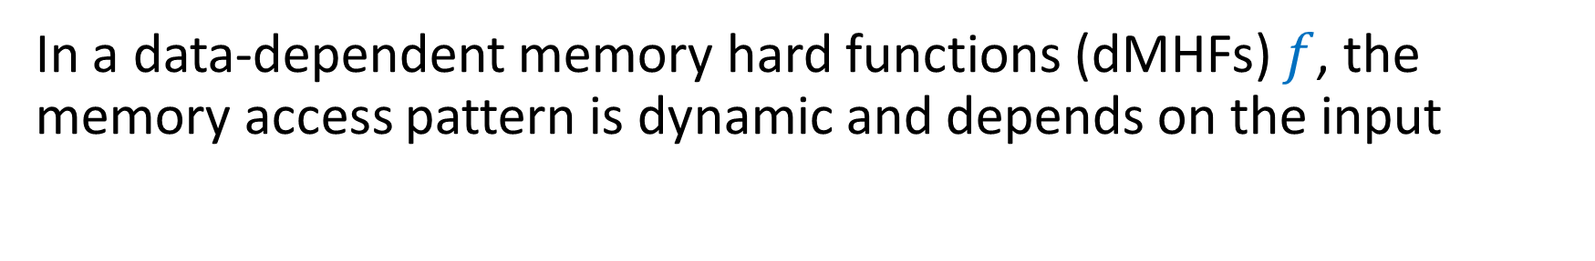
dMHFs
In a data-dependent memory hard functions (dMHFs) $f$, the memory access pattern is dynamic and depends on the input
3
4
6
2
2
1
different memory access pattern for $f(y)$
9
8, 5
9
1
7
4, 8
5,7
6
3
10, 10
RAM
Notes:
Then for the computation of f(y), where y is not equal to x, we may see a completely different memory access pattern.

Slide 8


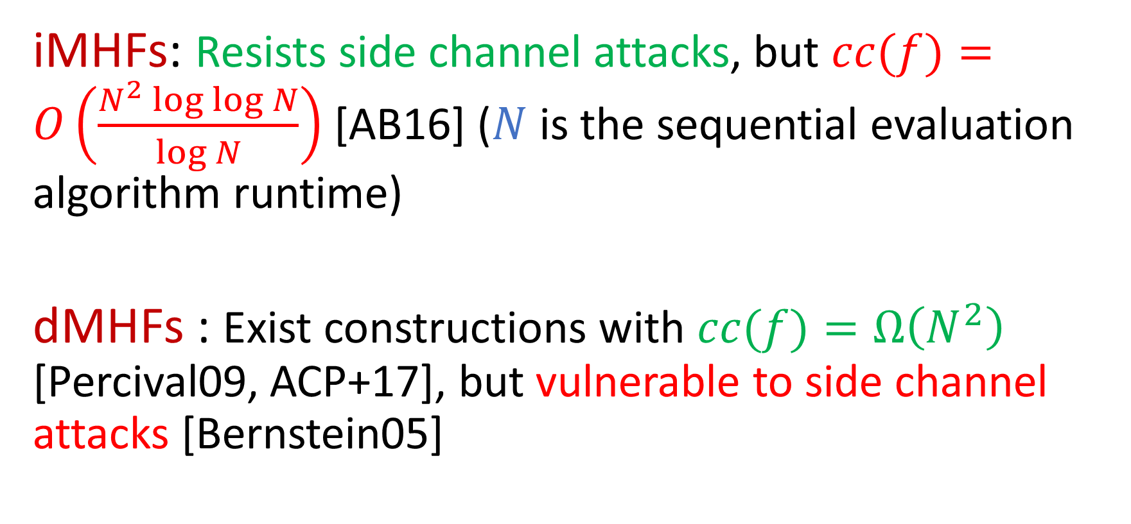
iMHFs vs. dMHFs
iMHFs: Resists side channel attacks, but $cc(f)=O\left(\frac{N^{2}\log{\log{N}}}{\log{N}}\right)$ [AB16] ($N$ is the sequential evaluation algorithm runtime)
dMHFs : Exist constructions with $cc(f)=Ω\left(N^{2}\right)$ [Percival09, ACP+17], but vulnerable to side channel attacks [Bernstein05]
optimal
Notes:
Because the memory access pattern is static across computations for different inputs, iMHFs are resistant to side channel attacks. However, known attacks show that the cumulative memory complexity of any iMHF is at most subquadratic in N, the runtime of the algorithm. On the other hand, there exist constructions of dMHFs whose cc is quadratic, which can easily be shown to be optimal. However, dMHFs are vulnerable to side channel attacks since their memory access patterns depend on the input.

Slide 9
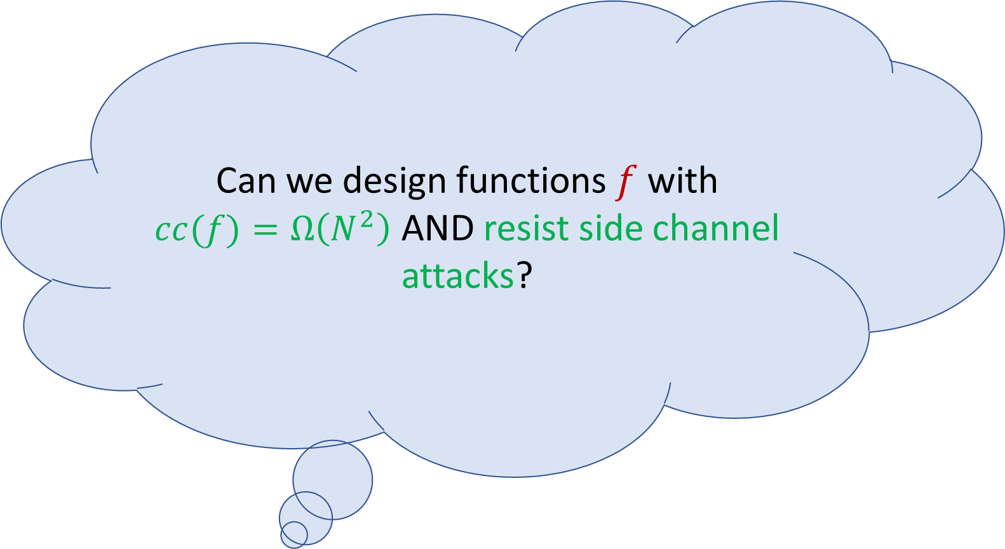
iMHFs vs. dMHFs
Can we design functions $f$ with $cc(f)=Ω\left(N^{2}\right)$ AND resist side channel attacks?
iMHFs: Resists side channel attacks, but $cc(f)=O\left(\frac{N^{2}\log{\log{N}}}{\log{N}}\right)$ [AB16] ($N$ is the sequential evaluation algorithm runtime)
dMHFs : Exist constructions with $cc(f)=Ω\left(N^{2}\right)$ [Percival09, ACP+17], but vulnerable to side channel attacks [Bernstein05]
optimal
Notes:
A natural question to ask is whether this tradeoff is necessary. That is, can we construct memory hard functions with optimal CC that are also resistant to side channel attacks.

Slide 10
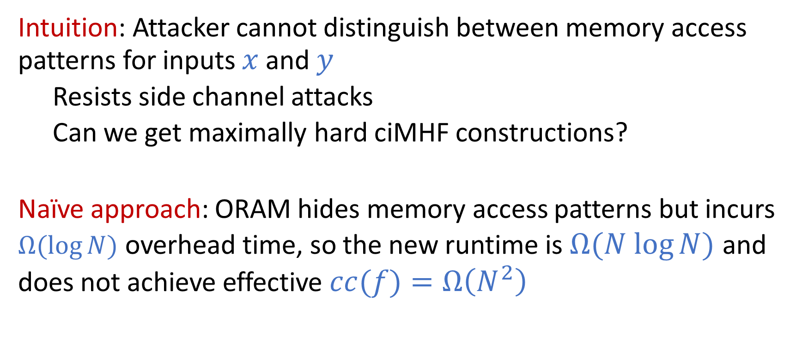
ciMHFs
Intuition: Attacker cannot distinguish between memory access patterns for inputs $x$ and $y$
Resists side channel attacks
Can we get maximally hard ciMHF constructions?
Naïve approach: ORAM hides memory access patterns but incurs $Ω(\log{N)}$ overhead time, so the new runtime is $Ω(N log{N)}$ and does not achieve effective $cc(f)=Ω\left(N^{2}\right)$
Notes:
To do this, we propose the concept of computationally data-independent memory hard function, or ciMHF. Intuitively, an attacker cannot distinguish between the memory access patterns for the computation of two distinct inputs. Moreover, the attacker is allowed to perform precomputation, so a ciMHF must be robust to side channel attacks. Now, a naïve approach to constructing an optimal ciMHF would be to hide the memory access pattern using something like ORAM. However, it’s known that ORAM requires a multiplicative log N overhead time, so even though the memory spent might be N^2, the new runtime would be N log N, so the effective cc would not be quadratic in the running time

Slide 11
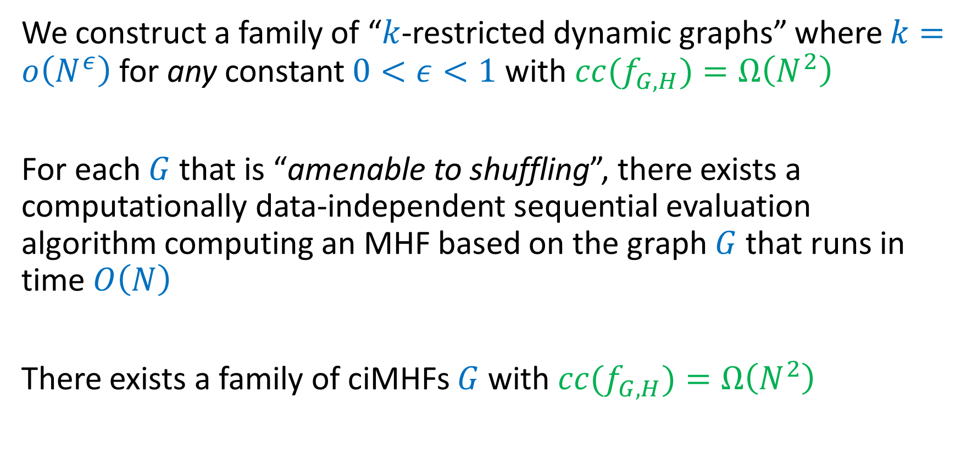
Our Contributions (I)
We construct a family of “$k$-restricted dynamic graphs” where $k=o\left(N^{ε}\right)$ for any constant $0<ε<1$ with $cc(f_{G,H})=Ω\left(N^{2}\right)$
For each $G$that is “amenable to shuffling”, there exists a computationally data-independent sequential evaluation algorithm computing an MHF based on the graph $G$ that runs in time $O\left(N\right)$
There exists a family of ciMHFs $G$ with $cc(f_{G,H})=Ω\left(N^{2}\right)$
Notes:
Instead, we define a concept called k restricted dynamic graphs, and construct a family of k restricted dynamic graphs that has asymptotically optimal cc, for values of k that are polynomial in N. However, these k restricted dynamic graphs are still dMHFs, so we define a property called “amenable to shuffling” that admits ciMHF constructions that run in time linear in N. Our constructions are amenable to shuffling, so this implies a ciMHF construction with optimal cc.

Slide 12
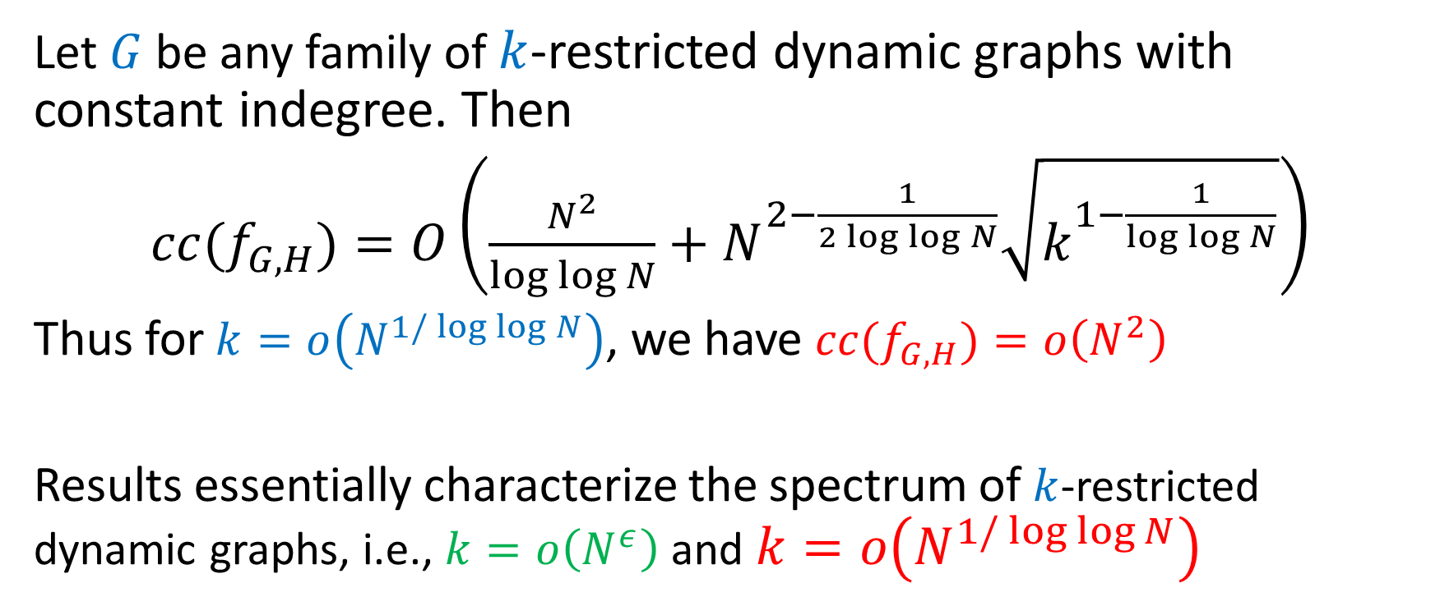
Our Contributions (II)
Let $G$ be any family of $k$-restricted dynamic graphs with constant indegree. Then
$cc(f_{G,H})=O\left(\frac{N^{2}}{\log{\log{N}}}+N^{2−\frac{1}{2\log{\log{N}}}}\sqrt{k^{1−\frac{1}{\log{\log{N}}}}}\right)$
Thus for $k=o\left(N^{1/\log{\log{N}}}\right)$, we have $cc(f_{G,H})=o\left(N^{2}\right)$
Results essentially characterize the spectrum of $k$-restricted dynamic graphs, i.e., $k=o\left(N^{ε}\right)$ and $k=o\left(N^{1/\log{\log{N}}}\right)$
Notes:
On the other hand, we show that for small values of k, it is impossible to obtain ciMHFs with optimal cc. Thus our results almost fully characterize the spectrum of k restricted dynamic graphs.

Slide 13


Assumption
Evaluation algorithm has (small) data structure that attacker cannot see
E.g., tiered memory architecture, where attacker can see access patterns to RAM but not cache
Notes:
We use the assumption that the evaluation algorithm has some small data structure that the attacker cannot see. For example, consider a tiered memory architecture where the attacker can see access patterns to RAM but not cache. Of course, the hidden data structure does not need to be small, but if it’s too large, then the side channel attack can be blocked from seeing most of the memory access pattern, which essentially gives ORAM for free and trivializes the problem.

Slide 14
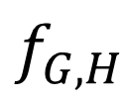
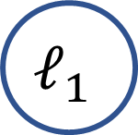
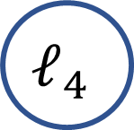
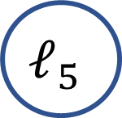
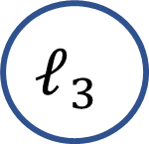
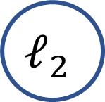
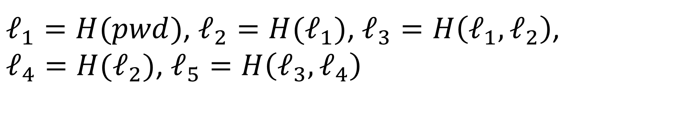
Memory Hard Functions [ABMW05, Percival09]
pwd
$$ℓ_{1}$$
$$ℓ_{2}$$
$$ℓ_{3}$$
$$ℓ_{5}$$
hash
$$f_{G,H}$$
$$ℓ_{4}$$
$ℓ_{1}=H(pwd)$, $ℓ_{2}=H(ℓ_{1})$, $ℓ_{3}=H\left(ℓ_{1},ℓ_{2}\right)$,
$ℓ_{4}=H(ℓ_{2})$,$ℓ_{5}=H\left(ℓ_{3},ℓ_{4}\right)$
Notes:
Before beginning the technical part of the talk, let me talk about a possible way of thinking about the computation of a memory hard function. Let’s suppose we have an underlying graph G and a function H. Each node in the graph has a label, where the label of a node is the function H applied to the concatenation of the labels of the parents of the node. Then the password is the input to the first node and the hash of the password is the label of the final node. For example, the label of the first node is H of the password, the label of the second node is H of L1, and the label of the third node is H of L1 and L2. Note that it’s difficult to compute the label of a node if we don’t know the label of one of its parents.

Slide 15
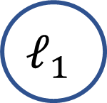

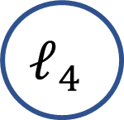
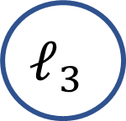

Dynamic and Static Graphs
$$ℓ_{1}$$
$$ℓ_{2}$$
$$ℓ_{3}$$
$$ℓ_{4}$$
$$ℓ_{5}$$
dMHF
Notes:
Note that I didn’t tell you how to get the underlying graph G. In a dMHF, the underlying graph is dynamically built. For example, in the scrypt dMHF, edges into the nodes in the second half of the graph depend on the data and thus are only revealed when the previous labels are computed.

Slide 16

Dynamic and Static Graphs
$$ℓ_{1}$$
$$ℓ_{2}$$
$$ℓ_{3}$$
$$ℓ_{4}$$
$$ℓ_{5}$$
dMHF
$$ℓ_{6}$$
Notes:
For example, once the first five labels are computed, then we can determine the incoming edge to node six and compute label six.

Slide 17
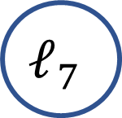
Dynamic and Static Graphs
$$ℓ_{1}$$
$$ℓ_{2}$$
$$ℓ_{3}$$
$$ℓ_{4}$$
$$ℓ_{5}$$
dMHF
$$ℓ_{6}$$
$$ℓ_{7}$$
Notes:
The incoming edge to node seven is then revealed and we can compute label seven.

Slide 18

Dynamic and Static Graphs
$$ℓ_{1}$$
$$ℓ_{2}$$
$$ℓ_{3}$$
$$ℓ_{4}$$
$$ℓ_{5}$$
dMHF
$$ℓ_{6}$$
$$ℓ_{7}$$
$$ℓ_{8}$$
Notes:
This process continues until the remaining edges are revealed and the last label is determined.

Slide 19

Dynamic and Static Graphs
$$ℓ_{1}$$
$$ℓ_{2}$$
$$ℓ_{3}$$
$$ℓ_{4}$$
$$ℓ_{5}$$
dMHF
$$ℓ_{6}$$
$$ℓ_{7}$$
$$ℓ_{8}$$
$$ℓ_{9}$$

Slide 20

Dynamic and Static Graphs
$$ℓ_{1}$$
$$ℓ_{2}$$
$$ℓ_{3}$$
$$ℓ_{4}$$
$$ℓ_{5}$$
dMHF
$$ℓ_{6}$$
$$ℓ_{7}$$
$$ℓ_{8}$$
$$ℓ_{9}$$
$$ℓ_{10}$$

Slide 21
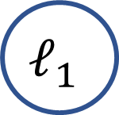


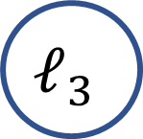
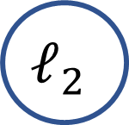
Dynamic and Static Graphs
$$ℓ_{1}$$
$$ℓ_{2}$$
$$ℓ_{3}$$
$$ℓ_{4}$$
$$ℓ_{5}$$
iMHF
Notes:
On the other hand, in an iMHF, the graph is static and determined before-hand, independent of the values of the labels.

Slide 22
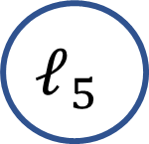
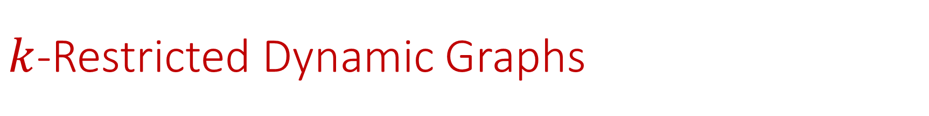
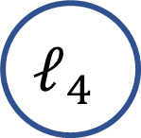


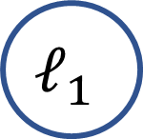
$k$-Restricted Dynamic Graphs
$$ℓ_{1}$$
$$ℓ_{2}$$
$$ℓ_{3}$$
$$ℓ_{4}$$
$$ℓ_{5}$$
dMHF
$$ℓ_{1}$$
$$ℓ_{2}$$
$$ℓ_{3}$$
$$ℓ_{4}$$
$$ℓ_{5}$$
iMHF
Notes:
We can characterize this dependency by defining a k-restricted dynamic graph to be a graph in which the parents of each node can be randomly selected, but only have at most k possibilities. Thus the previous scrypt dMHF can be viewed as a N-restricted dynamic graph and this iMHF can be viewed as a 2-restricted dynamic graph. Hence, a k-restricted dynamic graph serves as a continuum between iMHFs and dMHFs.

Slide 23


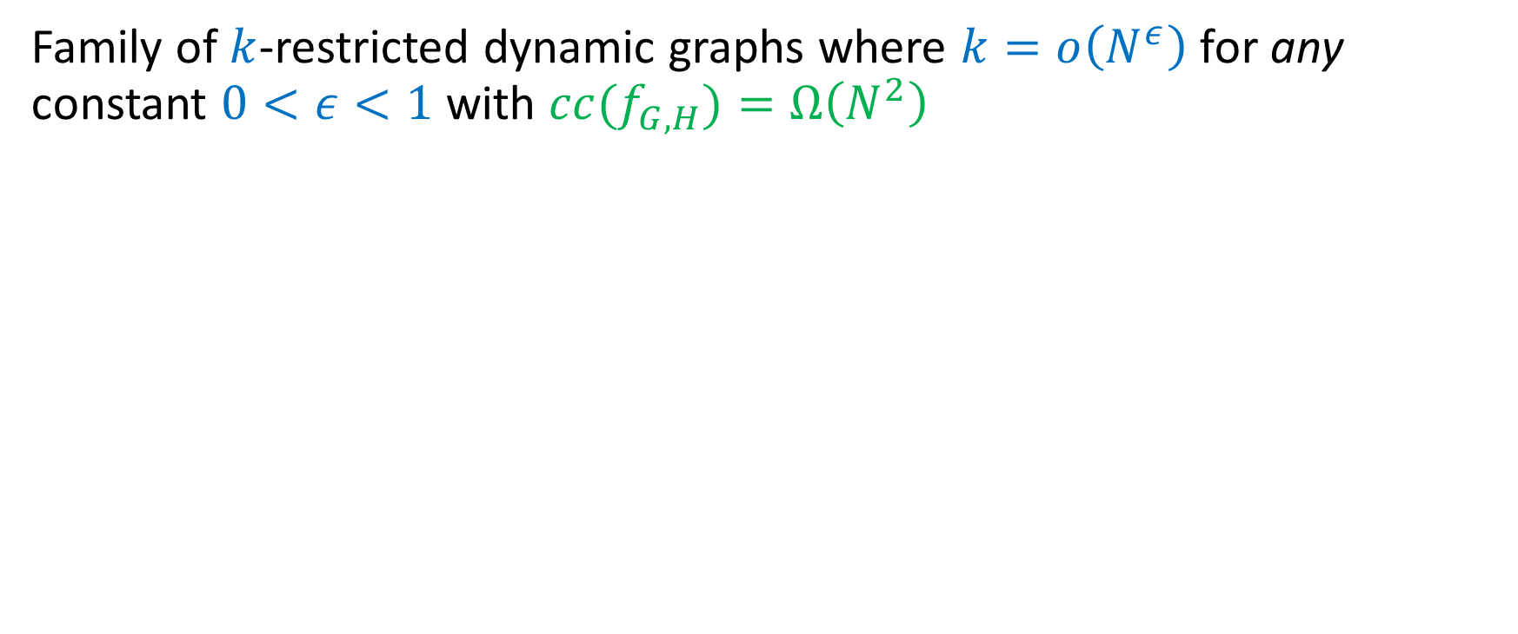
Maximally Hard $k$-Restricted Dynamic Graphs
Family of $k$-restricted dynamic graphs where $k=o\left(N^{ε}\right)$ for any constant $0<ε<1$ with $cc(f_{G,H})=Ω\left(N^{2}\right)$
…
$$N$$
Notes:
We construct a family of k-restricted dynamic graphs with optimal cc for k that is polynomial in N.

Slide 24
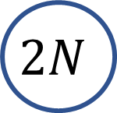
Maximally Hard $k$-Restricted Dynamic Graphs
Family of $k$-restricted dynamic graphs where $k=o\left(N^{ε}\right)$ for any constant $0<ε<1$ with $cc(f_{G,H})=Ω\left(N^{2}\right)$
…
$$N$$
…
$$2N$$
Notes:
The construction extends some predetermined graph on N nodes with a path of N more nodes.

Slide 25
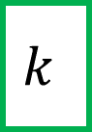
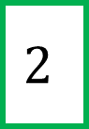
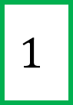
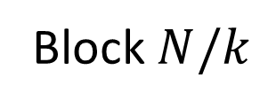
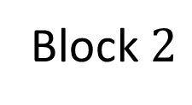
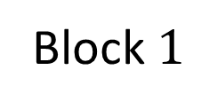
Maximally Hard $k$-Restricted Dynamic Graphs
Family of $k$-restricted dynamic graphs where $k=o\left(N^{ε}\right)$ for any constant $0<ε<1$ with $cc(f_{G,H})=Ω\left(N^{2}\right)$
$$1$$
$$2$$
…
$$k$$
…
…
…
Block $1$
Block $2$
Block $N/k$
…
$$2N$$
Notes:
We then break the first N nodes into blocks of size k.

Slide 26
Maximally Hard $k$-Restricted Dynamic Graphs
Family of $k$-restricted dynamic graphs where $k=o\left(N^{ε}\right)$ for any constant $0<ε<1$ with $cc(f_{G,H})=Ω\left(N^{2}\right)$
$$1$$
$$2$$
…
$$k$$
…
…
…
Block $1$
Block $2$
Block $N/k$
…
$$2N$$
Notes:
For each of the last N nodes, we then randomly choose a parent among the nodes in a block, in round robin fashion. So node N+1 will have a random parent from block 1, node N+2 will have a random parent from block 2, and so forth. Observe that the potential parents of any N/k consecutive nodes is all N nodes

Slide 27
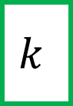


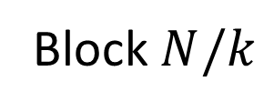
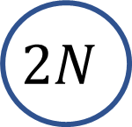
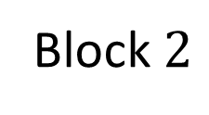
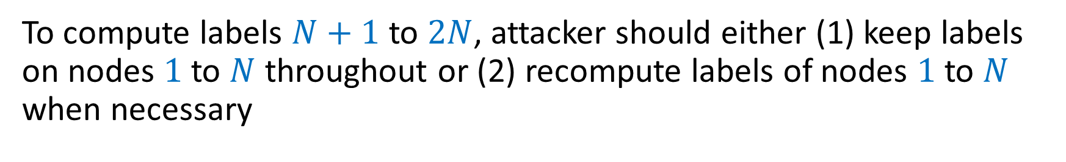
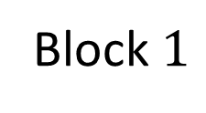
Maximally Hard $k$-Restricted Dynamic Graphs
$$1$$
$$2$$
…
$$k$$
…
…
…
Block $1$
Block $2$
Block $N/k$
…
$$2N$$
To compute labels $N+1$ to $2N$, attacker should either (1) keep labels on nodes $1$ to $N$ throughout or (2) recompute labels of nodes $1$ to $N$ when necessary
Notes:
Thus to compute labels N+1 to 2N, an attacker should roughly follow one of two extreme strategies.

Slide 28

Maximally Hard $k$-Restricted Dynamic Graphs
$$1$$
$$2$$
…
$$k$$
…
…
…
Block $1$
Block $2$
Block $N/k$
…
$$2N$$
To compute labels $N+1$ to $2N$, attacker should either (1) keep labels on nodes $1$ to $N$ throughout or (2) recompute labels of nodes $1$ to $N$ when necessary
Cost is $N×N=Ω(N^{2})$
Notes:
If the attacker choose to store the labels of nodes 1 to N for N steps, incurring a cost of N^2, or discard most of the labels 1 through N and then recompute them from scratch when they are needed.

Slide 29

Maximally Hard $k$-Restricted Dynamic Graphs
$$1$$
$$2$$
…
$$k$$
…
…
…
Block $1$
Block $2$
Block $N/k$
…
$$2N$$
To compute labels $N+1$ to $2N$, attacker should either (1) keep labels on nodes $1$ to $N$ throughout or (2) recompute labels of nodes $1$ to $N$ when necessary
Design the graph on nodes $1$ to $N$ to be very expensive to recompute!
Notes:
Thus we need to construct the graph on nodes 1 to N so that recomputing their labels is expensive and an attacker will commit to the first strategy because it is cheaper.

Slide 30
Maximally Hard $k$-Restricted Dynamic Graphs
Grates [Sch83]
Superconcentrators [Pip77,LT82]
$$1$$
$$2$$
…
$$k$$
…
…
…
Block $1$
Block $2$
Block $N/k$
Amenable to shuffling
…
$$2N$$
To compute labels $N+1$ to $2N$, attacker should either (1) keep labels on nodes $1$ to $N$ throughout or (2) recompute labels of nodes $1$ to $N$ when necessary
Design the graph on nodes $1$ to $N$ to be very expensive to recompute!
Notes:
We construct the graph on nodes 1 to N by this using ingredients called grates graphs and superconcentrators, which at a high level will require the computation of a large fraction of the first N labels, which is prohibitively expensive. Our construction can be tweaked to satisfy a property that we call “amenable to shuffling” and we give a sequential evaluation algorithm with linear runtime for any construction that is amenable to shuffling that is computationally data-independent.

Slide 31

Maximally Hard $k$-Restricted Dynamic Graphs
Grates [Sch83]
Superconcentrators [Pip77,LT82]
$$1$$
$$2$$
…
$$k$$
…
…
…
Block $1$
Block $2$
Block $N/k$
ciMHF with optimal $cc$
Amenable to shuffling
…
$$2N$$
To compute labels $N+1$ to $2N$, attacker should either (1) keep labels on nodes $1$ to $N$ throughout or (2) recompute labels of nodes $1$ to $N$ when necessary
Design the graph on nodes $1$ to $N$ to be very expensive to recompute!
Notes:
Thus this implies a ciMHF construction with optimal cc.

Slide 32


Attack on $k$-Restricted Dynamic Graphs
For $k=o\left(N^{1/\log{\log{N}}}\right)$, we have $cc(f_{G,H})=o\left(N^{2}\right)$
To compute labels $N+1$ to $2N$, attacker should either (1) keep labels on nodes $1$ to $N$ throughout or (2) recompute labels of nodes $1$ to $N$ when necessary
Previously: Design the graph on nodes $1$ to $N$ to be very expensive to recompute labels??
Attack: always recompute labels because no longer possible to be very expensive for small $k$, similar strategy to [AB16]
Notes:
On the other hand, if k is small, we give an attack that generalizes ideas from [AB16]. The intuition is that for small k, we can no longer design a graph on nodes 1 to N that is expensive to compute. Thus an attacker can keep a small number of labels in memory and quickly recompute the remaining labels from scratch when necessary.

Slide 33

Attack on $k$-Restricted Dynamic Graphs
For $k=o\left(N^{1/\log{\log{N}}}\right)$, we have $cc(f_{G,H})=o\left(N^{2}\right)$
To compute labels $N+1$ to $2N$, attacker should either (1) keep labels on nodes $1$ to $N$ throughout or (2) recompute labels of nodes $1$ to $N$ when necessary
Previously: Design the graph on nodes $1$ to $N$ to be very expensive to recompute labels??
Attack: always recompute labels because no longer possible to be very expensive for small $k$, similar strategy to [AB16]
Valiant’s Lemma [Val77]: Keep labels of a small number of key locations
Notes:
Moreover, this attack is explicit. The attacker can use Valiant’s lemma to determine which labels that should be kept at each time, which ultimately gives a subquadratic cc.

Slide 34



Summary
We construct a family of $k$-restricted dynamic graphs where $k=o\left(N^{ε}\right)$ for any constant $0<ε<1$ with $cc\left(f_{G,H}\right)=Ω\left(N^{2}\right)$ and give a ciMHF implementation of $f_{G,H}$
We show that $cc(f_{G,H})=o\left(N^{2}\right)$ for $k=o\left(N^{1/\log{\log{N}}}\right)$
Notes:
In summary, we give a ciMHF construction with optimal cc for k-restricted graphs, where k is polynomial in N. On the other hand, we show that for small k, it is impossible to achieve optimal cc, which demonstrates a nice phase transition for the spectrum of k-restricted graphs.

Slide 35


Future Directions
Fully characterize and tighten bounds for the spectrum of $k$-restricted dynamic graphs
Optimal ciMHFs without cache hierarchy assumptions
Show pebbling reduction for dMHFs
Notes:
I think there are many interesting future directions to explore. For example, we could fully characterize and tighten the bounds for the spectrum of k restricted graphs. We could also consider optimal ciMHFs without cache hierarchy assumptions.

Slide 36
Graph Pebbling
pwd
hash
$$f_{G,H}$$
$$\left|P_{1}\right|=1$$
Notes:
This process can be roughly captured by the concept of graph pebbling. We can think of graph pebbling as a game that proceeds in a number of rounds, where in each round, the graph has a number of pebbles on its nodes, which symbolizes that memory is being committed to store the label of that node. In each round, we can choose to place a pebble on any source node of the graph, or remove any pebble on the graph from the previous round.

Slide 37
Graph Pebbling
pwd
hash
$$f_{G,H}$$
$$\left|P_{1}\right|+\left|P_{2}\right|=1+2=3$$
Notes:
We can also place a pebble on a node if there are pebbles on all of its parents in the previous round. In other words, we can only compute the label of a node if we’ve computed the labels of its parents.

Slide 38
Graph Pebbling
pwd
hash
$$f_{G,H}$$
$$\left|P_{1}\right|+\left|P_{2}\right|+\left|P_{3}\right|=1+2+2=5$$
Notes:
Now if we take the sum of the number of pebbles on the graph in each round, this corresponds to the total amount of memory used to compute the MHF, which is the cumulative memory complexity.

Slide 39



Graph Pebbling
pwd
hash
$$f_{G,H}$$
$${cc(f}_{G,H})=O\left(N^{2}\right)$$
$$\sum_{i=1}^{4}{|P_{i}|}=1+2+2+1=6$$
$${cc(f}_{G,H})=6$$
Notes:
Thus, the cc of this graph is 6, and now it should be clear that any algorithm that runs in time N has cc at most N^2, since at most N pebbles can be on the graph at each time.

Slide 40

Computationally Data-Independent
Setup: Adversary selects two challenge messages $m_{0}$ and $m_{1}$ and sends them to honest party. Assume runtime of evaluation algorithm are the same and LRU/FIFO cache policies on tiered memory architecture
Challenge: Honest party chooses fresh randomness $R_{0},R_{1}$, $b∈\{0,1\}$ uniformly at random, and sends memory access pattern of the evaluation algorithm on $m_{b}$ with randomness $R_{b}$ to the adversary
Guess: Adversary makes a guess $b′$ for $b$ and wins if $b=b′$
Computational data independency: Advantage of adversary is negligible

Slide 41

Amenable to Shuffling
For each $G$that is “amenable to shuffling”, there exists a computationally data-independent sequential evaluation algorithm computing an MHF based on the graph $G$ that runs in time $O\left(N\right)$
Given a graph $G$ with $cN$ nodes, let $L$ be the last $N$ nodes of $G$. Suppose $L$ can be partitioned into groups $G_{1},…G_{N/k}$ such that
(1) Each group has size $k$ (2) Each nodes in $L$ has $k$ potential parents, none of which are in $L$ (3) Vertices in the same group have the same potential parents (4) Vertices in different groups have no potential parents in common (5) No vertex has the same parent

Slide 42

Amenable to Shuffling
For each $G$that is “amenable to shuffling”, there exists a computationally data-independent sequential evaluation algorithm computing an MHF based on the graph $G$ that runs in time $O\left(N\right)$
$$1$$
$$2$$
…
$$k$$
…
…
…
Block $1$
Block $2$
Block $N/k$
…
$$2N$$

Slide 43



Amenable to Shuffling
For each $G$that is “amenable to shuffling”, there exists a computationally data-independent sequential evaluation algorithm computing an MHF based on the graph $G$ that runs in time $O\left(N\right)$
$$k$$
$$5$$
…
$$2$$
…
…
…
Block $1$
Block $2$
Block $N/k$
…
$$2N$$

Slide 44

















Notes:
Let’s start the talk by considering the following wall of shame. Most of you probably know all of these companies, but what you may not know is that all of these companies were the victim of recent attacks.

Slide 45

Notes:
As a result, these companies leaked millions of user records. So what happens when a user record is leaked?

Slide 46

Notes:
Suppose I’m a hacker and I break into the user database of one of these companies. Then what I’ll see is a list of users and their passwords, or if the company maintains good practice, a list of users and the hash of their passwords, along with the function used to encode the password to the hash.

Slide 47

Source: SkyHigh
Notes:
Now if I have the hash of your password and I’m trying to guess your password but I don’t know anything about you, then what I’m going to do is take the most common passwords, compute their hashes, and compare those hashes to the hash of your password. If the hashes match, then there’s a good chance I’ve guessed your password.

Slide 48



56 trillion hashes per second
[BHZ19] showed economic adversary likely to guess your (medium-entropy) password if the hash is iterative based, i.e., $hash=H^{N}\left(pwd\right)$.
All entrants claimed some sort of memory hardness, e.g., Argon2 [BDK13], Catena [FLW13], Balloon Hashing [CBS16]
Notes:
Thanks to the development of customized hardware for cryptocurrency computation, I can actually make a large number of guesses for your password in a short amount of time. In fact, Blocki et al showed that I’m likely to guess your password if the function used to compute the hash is based on iterations. Thus there’s been a lot of interest in designing better hash functions. Between 2013 and 2015, there was a contest to see who could design the best hash function, and it turns out that all of the entrants claimed a concept known as memory hardness.

